Slide 1


Zagadou Oyotode
1st Feb 2023

Slide 2

Outline
Executive Summary
Introduction
Methodology
Results
Conclusion
Appendix

Slide 3
Executive Summary
Summary of methodologies
Data Collection through API
Data Collection with Web Scraping
Data Wrangling
Exploratory Data Analysis with SQL
Exploratory Data Analysis with Data Visualization
Interactive Visual Analytics with Folium
Machine Learning Prediction
Summary of all results
Exploratory Data Analysis result
Interactive analytics in screenshots
Predictive Analytics result

Slide 4
Introduction
Project background and context
Falcon 9 rocket launches cost 62 million dollars to Space X while its competitors have a cost close to 165 million dollars. This competitive advantage comes from the fact that Space X is able to re-used its 1st stage ricket only if it lands back successfully.
Therefore, determining the probability of a successful launches will help us predict the cost of launches.
The following slides contains a break down of our analysis
Problems you want to find answers
What factors drive successfully landings?
How do these factors interact with each other?
What operating conditions needs to be in place to ensure successful landing?.

Slide 5


Slide 6
Methodology
Executive Summary
Data collection methodology:
Data was collected using SpaceX API and web scraping from Wikipedia.
Perform data wrangling
One-hot encoding was applied to categorical features
Perform exploratory data analysis (EDA) using visualization and SQL
Perform interactive visual analytics using Folium and Plotly Dash
Perform predictive analysis using classification models
How to build, tune, evaluate classification models

Slide 7
Data Collection
Process
Data collection was done using get request to the SpaceX API.
Next, we decoded the response content as a Json using .json() function call and turn it into a pandas dataframe using .json_normalize().
Filter the dataframe to only include Falcon 9 launches
We then cleaned the data, checked for missing values and fill in missing values where necessary

Slide 8
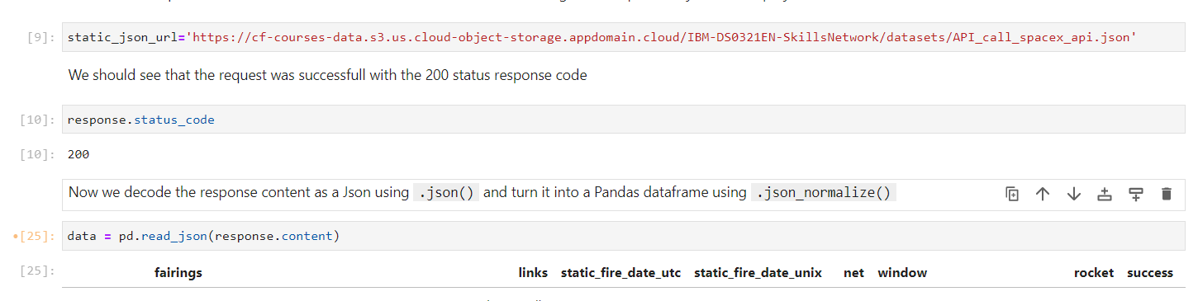
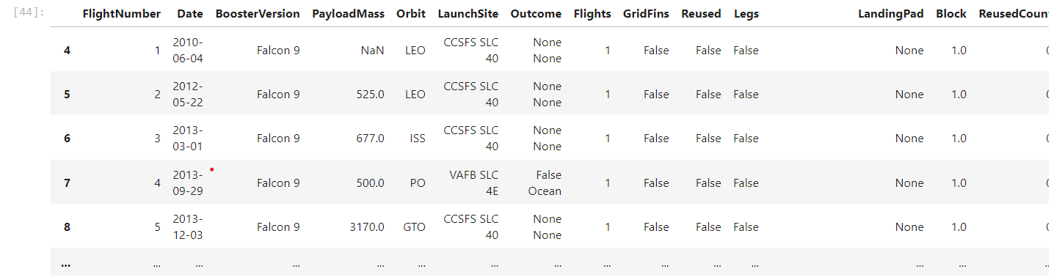
Data Collection – SpaceX API
We used the get request to the SpaceX API to collect data (Picture1), clean the requested data and did some basic data wrangling and formatting (Picture2: Final data).
The link to the notebook is
https://github.com/Zagado/Applied-Data-Science-Capstone-Project.git

Slide 9

Data Wrangling
We performed exploratory data analysis and determined the training labels.
We calculated the number of launches at each site, and the number and occurrence of each orbits
We created landing outcome label from outcome column and exported the results to csv.
The link to the notebook is https://github.com/Zagado/Applied-Data-Science-Capstone-Project.git

Slide 10
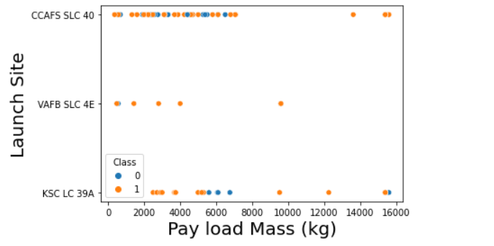
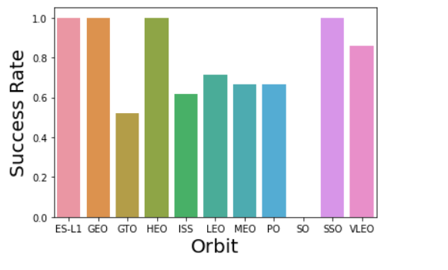
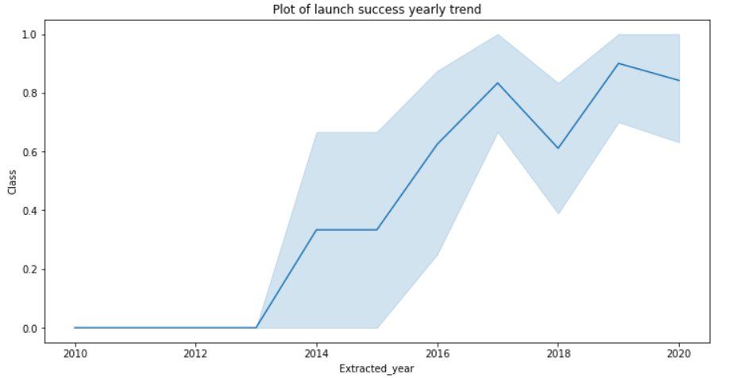
EDA with Data Visualization
We explored the data by visualizing the relationship between flight number and launch Site, payload and launch site, success rate of each orbit type, flight number and orbit type, the launch success yearly trend.
You can observe that the success rate since 2013 kept increasing till 2020. With heavy payloads the successful landing or positive landing rate are more for Polar,LEO and ISS. However for GTO we cannot distinguish this well as both positive landing rate and negative landing(unsuccessful mission) are both there here.
The link to the notebook is https://github.com/Zagado/Applied-Data-Science-Capstone-Project.git

Slide 11
EDA with SQL
We loaded the SpaceX dataset into a SQL database without leaving the jupyter notebook using SQLite
We wrote queries for:
The names of unique launch sites in the space mission.
Display 5 records where launch sites begin with the string 'CCA'
The total payload mass carried by boosters launched by NASA (CRS)
The average payload mass carried by booster version F9 v1.1
List the date when the first successful landing outcome in ground pad was achieved
List the names of the boosters which have success in drone ship and have payload mass greater than 4000 but less than 6000
The total number of successful and failure mission outcomes
List the names of the booster_versions which have carried the maximum payload mass. Use a subquery
Rank the count of successful landing_outcomes between the date 04-06-2010 and 20-03-2017 in descending order.
The failed landing outcomes in drone ship, their booster version and launch site names.
The link to the notebook is https://github.com/Zagado/Applied-Data-Science-Capstone-Project.git

Slide 12
Build an Interactive Map with Folium
All launch sites were marked, and map objects such as markers, circles, lines were used to mark the success or failure of launches for each site on the folium map.
We assigned the feature launch outcomes (failure or success) to class 0 and 1.i.e., 0 for failure, and 1 for success.
Using the color-labeled marker clusters, we identified which launch sites have relatively high success rate.
We calculated the distances between a launch site to its proximities. We answered some question for instance:
Are launch sites near railways, highways and coastlines.
Do launch sites keep certain distance away from cities.

Slide 13
Build a Dashboard with Plotly Dash
We built an interactive dashboard with Plotly dash
We plotted pie charts showing the total launches by a certain sites
We plotted scatter graph showing the relationship with Outcome and Payload Mass (Kg) for the different booster version.
The link to the notebook is https://github.com/Zagado/Applied-Data-Science-Capstone-Project.git

Slide 14
Predictive Analysis (Classification)
We loaded the data using numpy and pandas, transformed the data, split our data into training and testing.
We built different machine learning models and tune different hyperparameters using GridSearchCV.
We used accuracy as the metric for our model, improved the model using feature engineering and algorithm tuning.
We found the best performing classification model.
The link to the notebook is https://github.com/Zagado/Applied-Data-Science-Capstone-Project.git

Slide 15
Results
Exploratory data analysis results
Interactive analytics demo in screenshots
Predictive analysis results

Slide 16


Slide 17
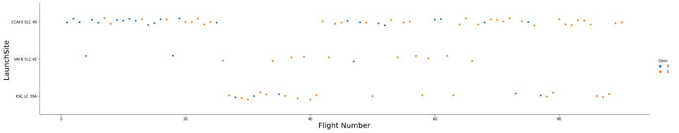
Flight Number vs. Launch Site
From the plot, we found that the larger the flight amount at a launch site, the greater the success rate at a launch site.
We see that as the flight number increases, the first stage is more likely to land successfully for site CCAFS SLC. For the other sites, no so much.

Slide 18
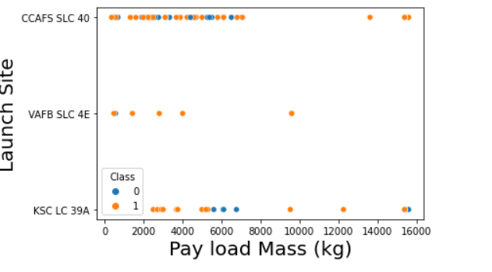
Payload vs. Launch Site
For the VAFB-SLC launchsite there are no rockets launched for heavypayload mass(greater than 10000).
For CCAFS SLC 40, success rate increase as load mass increases

Slide 19
Success Rate vs. Orbit Type
From the plot, we can see that ES-L1, GEO, HEO, SSO, VLEO had the most success rate.
SO has the lowest success rate

Slide 20
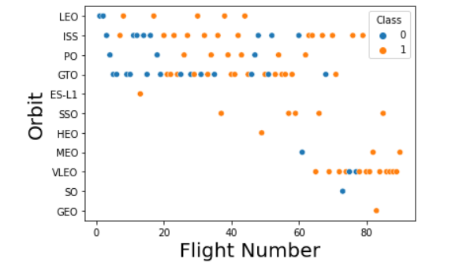
Flight Number vs. Orbit Type
The plot below shows the Flight Number vs. Orbit type. We observe that in the LEO orbit, success is related to the number of flights whereas in the GTO orbit, there is no relationship between flight number and the orbit.

Slide 21
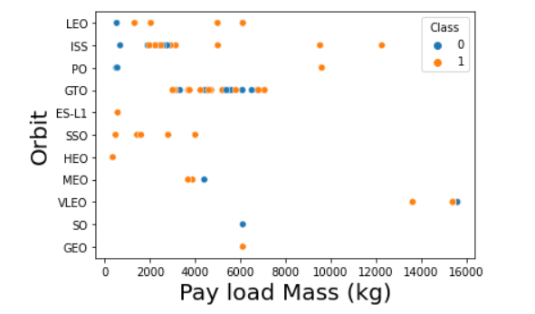
Payload vs. Orbit Type
We can observe that with heavy payloads, the successful landing are more for PO, LEO and ISS orbits.

Slide 22
Launch Success Yearly Trend
From the plot, we can observe that success rate since 2013 kept on increasing till 2020.

Slide 23
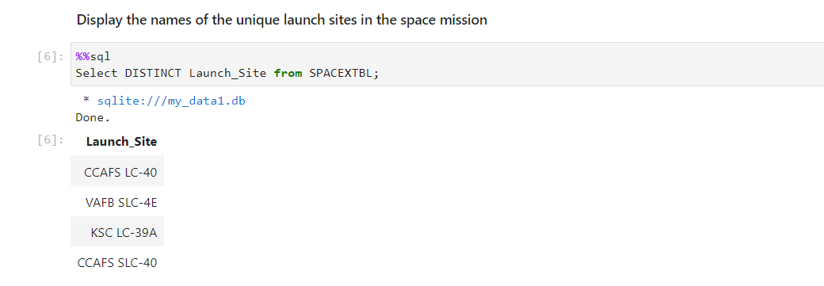
All Launch Site Names
We used the key word DISTINCT to show only unique launch sites from the SpaceX data

Slide 24
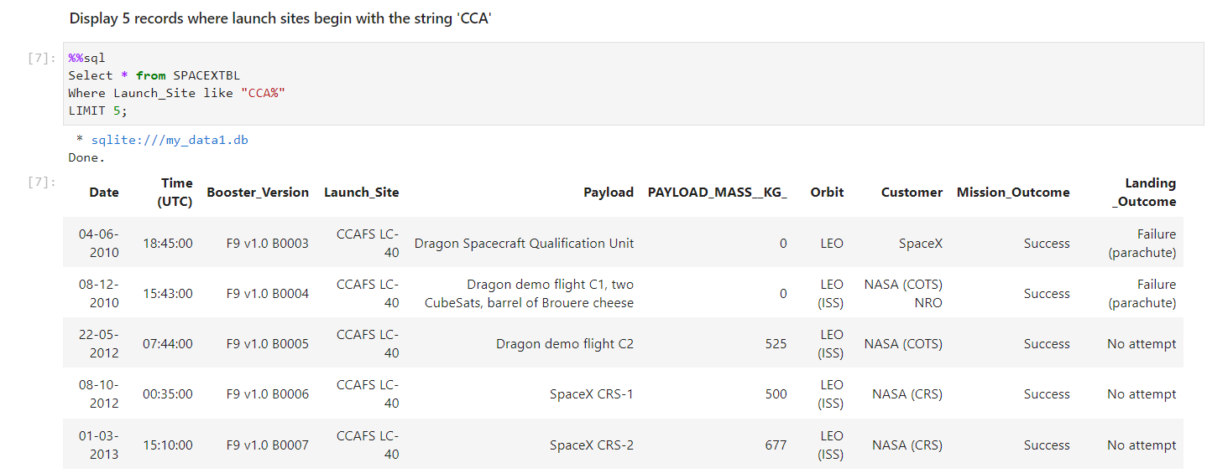
Launch Site Names Begin with 'CCA'
We used the query above to display 5 records where launch sites begin with `CCA`

Slide 25
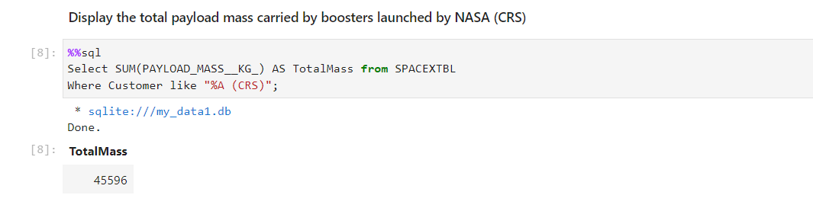
Total Payload Mass
We calculated the total payload carried by boosters from NASA as 45596 using the query below

Slide 26
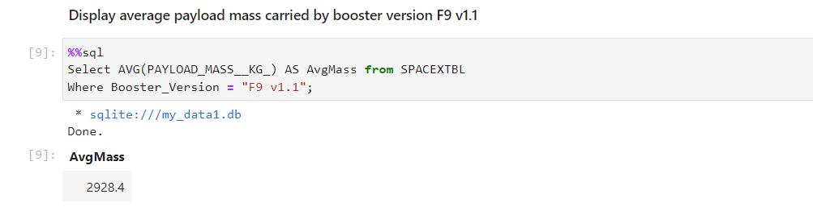
Average Payload Mass by F9 v1.1
We calculated the average payload mass carried by booster version F9 v1.1 as 2928.4

Slide 27
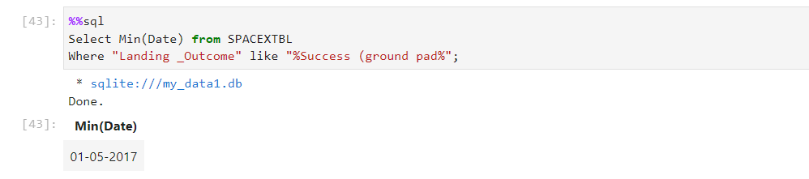
First Successful Ground Landing Date
We observed that the dates of the first successful landing outcome on ground pad was 22nd December 2015

Slide 28
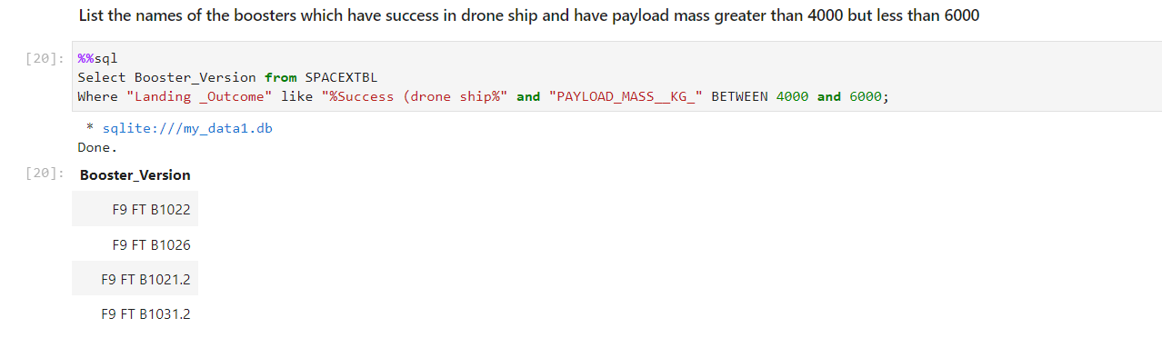
Successful Drone Ship Landing with Payload between 4000 and 6000
We used the WHERE clause to filter for boosters which have successfully landed on drone ship and applied the AND condition to determine successful landing with payload mass greater than 4000 but less than 6000

Slide 29
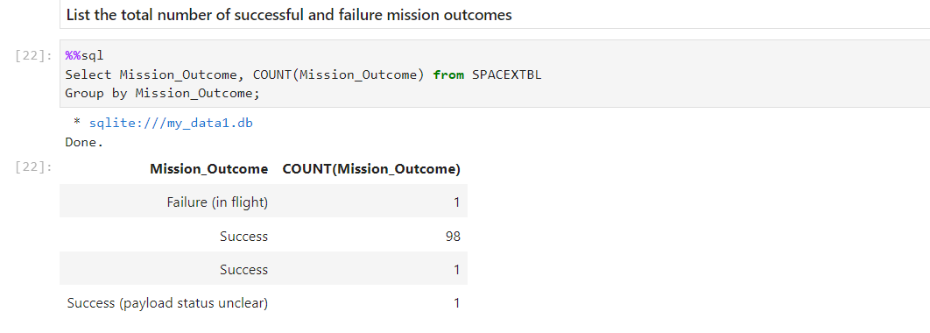
Total Number of Successful and Failure Mission Outcomes
We used the group by to find the count of outcomes for each possible mission outcomes.

Slide 30
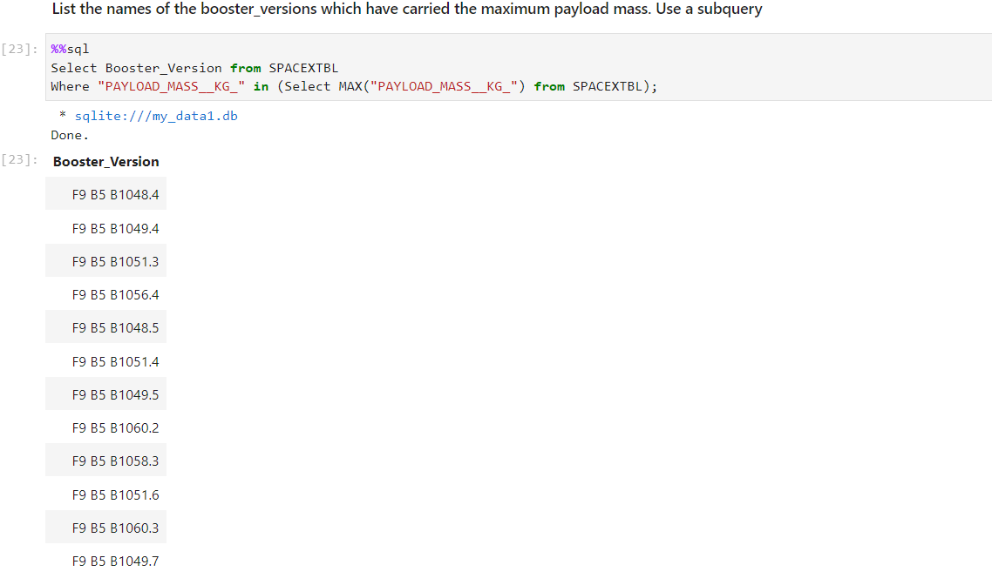
Boosters Carried Maximum Payload
We determined the booster that have carried the maximum payload using a subquery in the WHERE clause and the MAX() function.

Slide 31
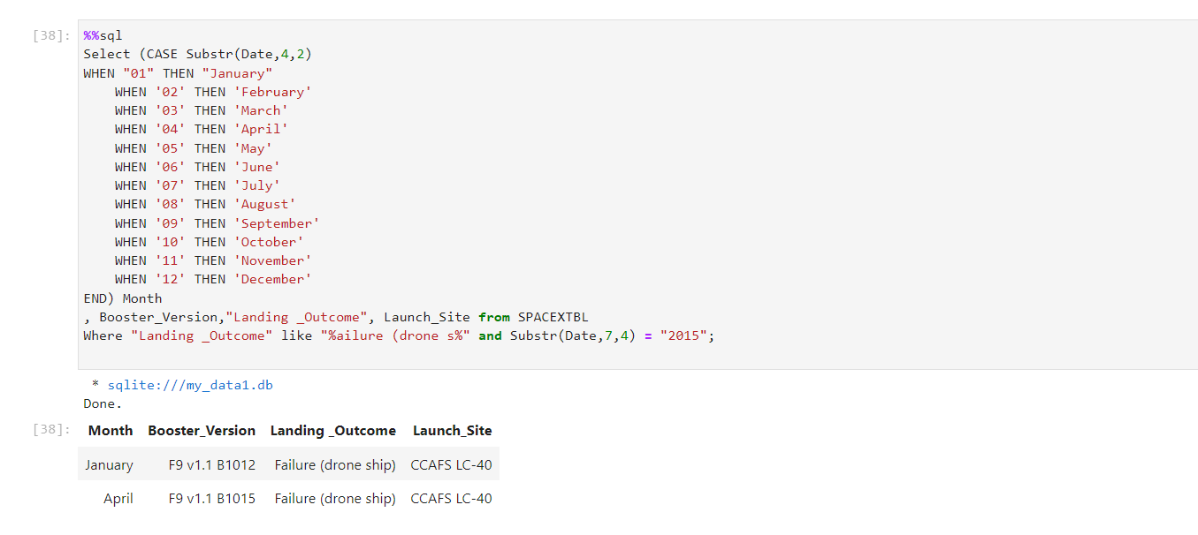
2015 Launch Records
We used a combinations of the WHERE clause, LIKE, AND, and BETWEEN conditions to filter for failed landing outcomes in drone ship, their booster versions, and launch site names for year 2015

Slide 32
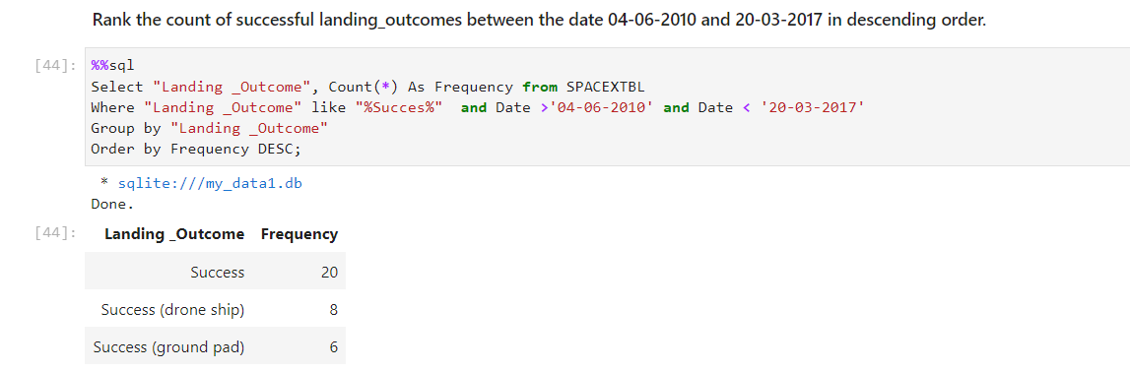
Rank Landing Outcomes Between 2010-06-04 and 2017-03-20
We selected Landing outcomes and the COUNT of landing outcomes from the data and used the WHERE clause to filter for landing outcomes BETWEEN 2010-06-04 to 2010-03-20.
We applied the GROUP BY clause to group the landing outcomes and the ORDER BY clause to order the grouped landing outcome in descending order.

Slide 33


Slide 34
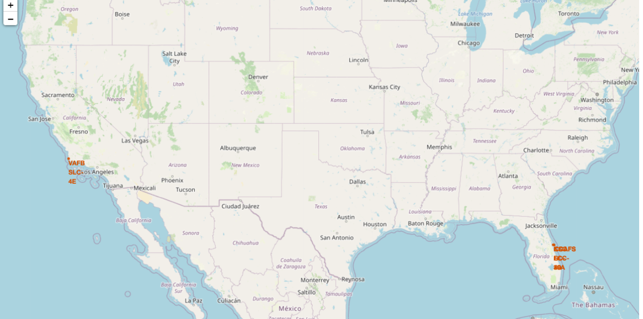
All launch sites global map markers

Slide 35

Markers showing launch sites with color labels

Slide 36
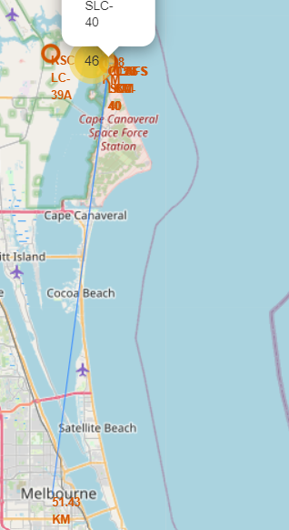
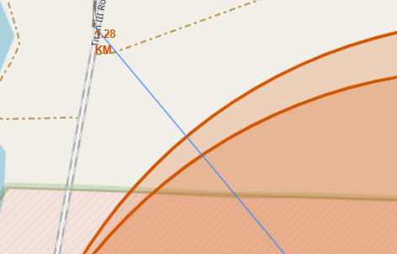
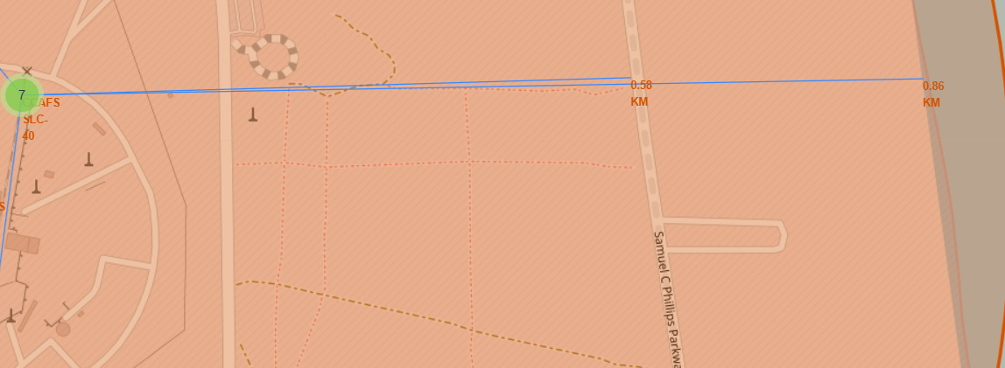
Launch Site distance to landmarks – CCAFS SLC-40
Distance from CCAFS SLC-40 to:
Railway: 1.28KM
City: 51.43KM
Coastline: 0.86KM
Highway: 0.58KM
Most landmarks are far from the launch site except the highway and coastline.

Slide 37


Slide 38

Pie chart showing the success percentage achieved by each launch site

Slide 39
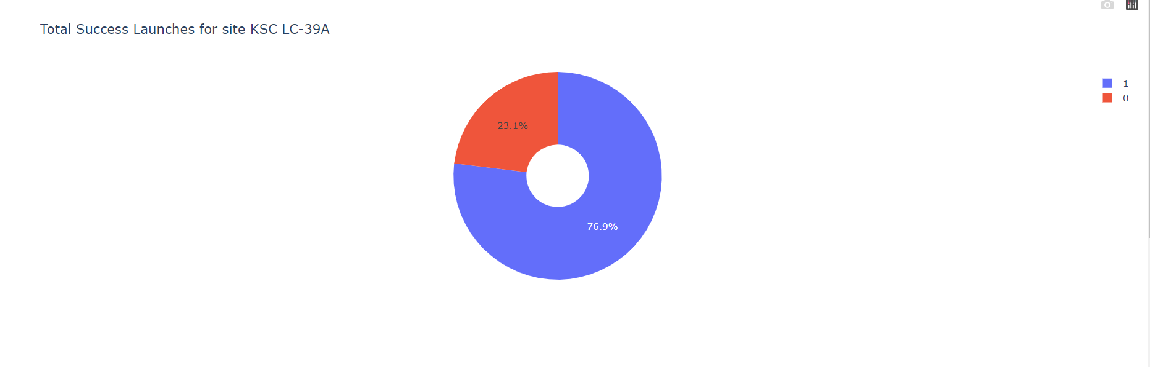
Pie chart showing the Launch site with the highest launch success ratio
Success rate = 76.9%
Failure rate = 23.1%

Slide 40

Payload vs. Launch Outcome scatter plot for all sites, with different payload selected in the range slider

Slide 41


Slide 42
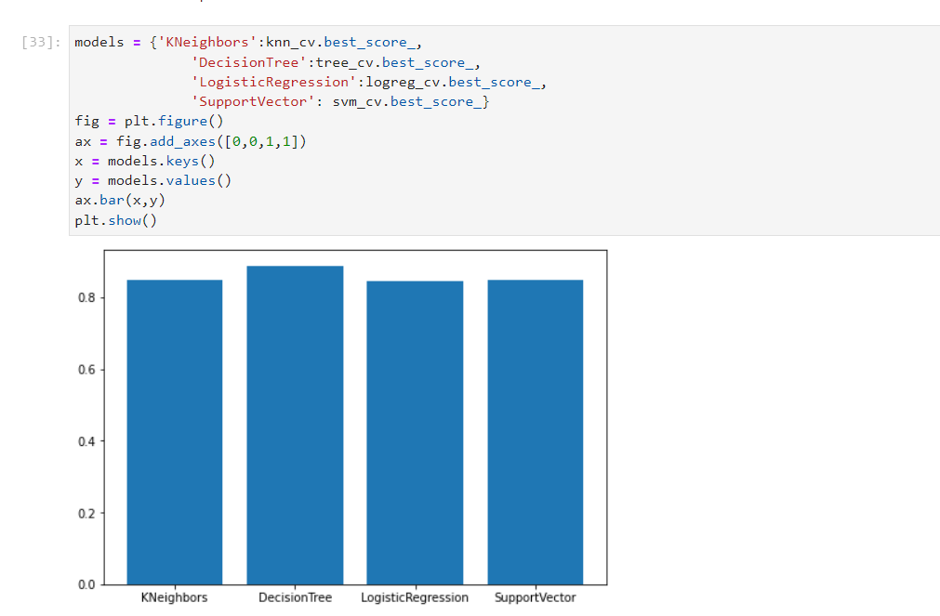
Classification Accuracy
Classification Accuracy
The decision tree classifier is the model with the highest classification accuracy
42

Slide 43

Confusion Matrix
The confusion matrix for the decision tree classifier shows that the classifier can distinguish between the different classes. The major problem is the false positives .i.e., unsuccessful landing marked as successful landing by the classifier.

Slide 44
Conclusions
We can conclude that:
The larger the flight amount at a launch site, the greater the success rate at a launch site.
Launch success rate started to increase in 2013 till 2020.
Orbits ES-L1, GEO, HEO, SSO, VLEO had the most success rate.
KSC LC-39A had the most successful launches of any sites.
The Decision tree classifier is the best machine learning algorithm to predict the success rate in our case.

Slide 45


